Slide 1
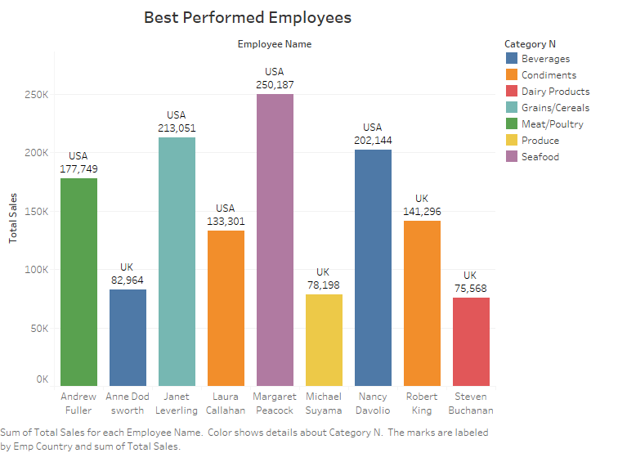
Best Performed Employee
Margret Peacock from the USA is the best performed employee with a sale over 250000.
The USA also has the highest sales with the top 4 being from there.
Condiments also sell about the same in the USA and the UK.

Slide 2
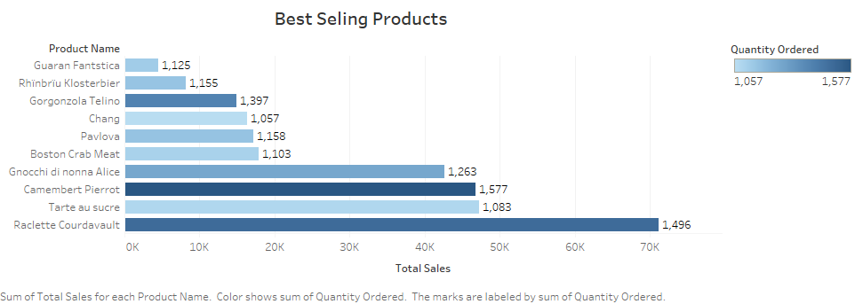
Best Selling Products
Raclette Courdavault is the best-selling product and has the second highest quantity ordered while Camembert Pierrot is the third best selling but is the most ordered.

Slide 3
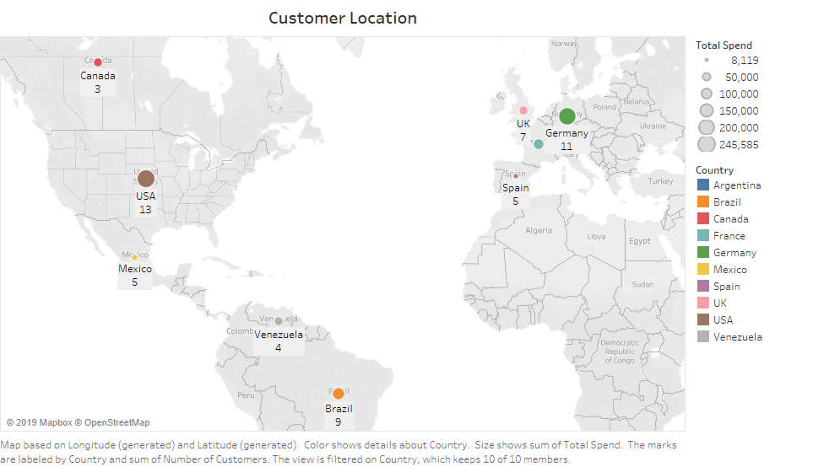
Most Customer’s location and Total Spend per Country
USA has the most customers with also the largest total spend.
11 customers are both from Germany and France but the former has a larger total spend.

Slide 4
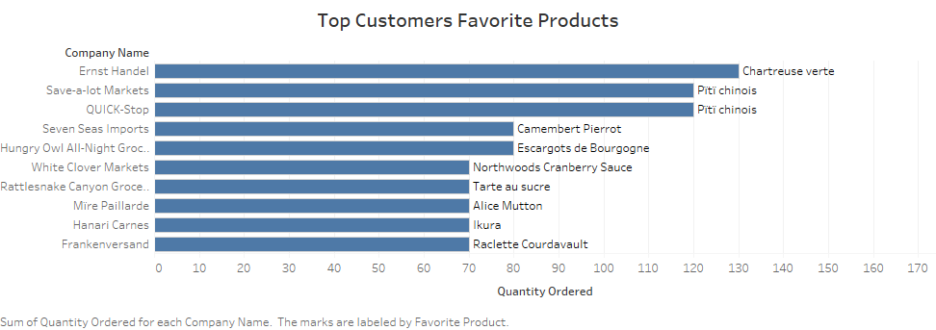
Top Customer’s Favorite Products
The chart shows top 10 spending customers with their favorite products.

Slide 5
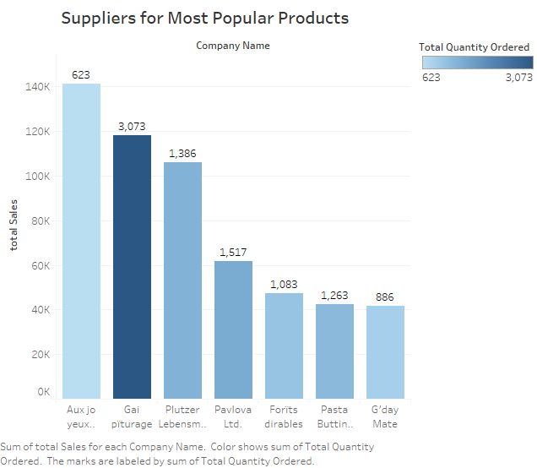
Suppliers for Most Popular Products
There are 7 suppliers with Aux Joyeux supplying the top product; Cote de Blaye.
Gai puturage supplies the products with the highest quantity ordered.

Slide 6
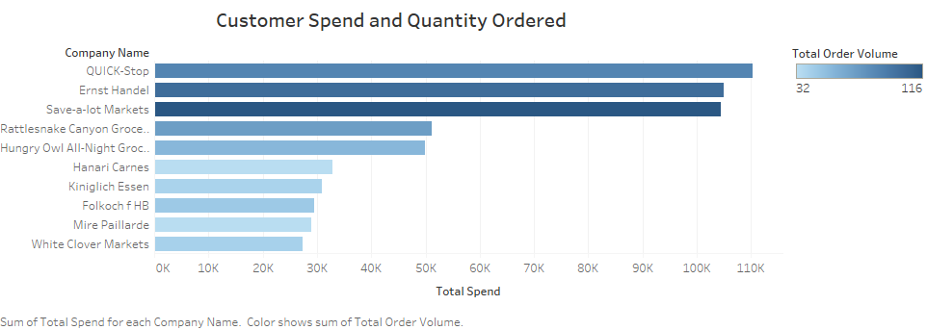
Customer Total Spend and Quantity Ordered
Quick-Stop is the highest spending customer with about 110000 spent while Save-a-lot has ordered the most and is the third highest spender.

